Slide 1
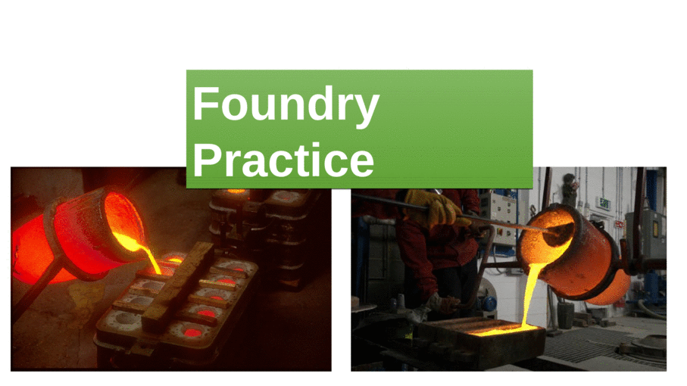
FOUNDRY
SESSIONAL
Notes:
FOUNDRY SESSIONAL

Slide 2
General Foundry Safety
Before using any equipments or materials, proper knowledge of its usage is required.
Wear leather shoes, gloves, and safety glasses while working in an foundry environment.
Foundry furnaces, crucibles, and metals are at very high temperature, remain cautious while you work.
Be conscious of where your hands are when working with conveyors and automated machinery.
Molten metal that is spilled can travel a great distance, so keep the work area clear.
Melting metal create fumes that can be hazardous to breathe.
Molding sand contains silica. Silica dust exposure can lead to silicosis, a lung disease, or lung cancer.

Slide 3
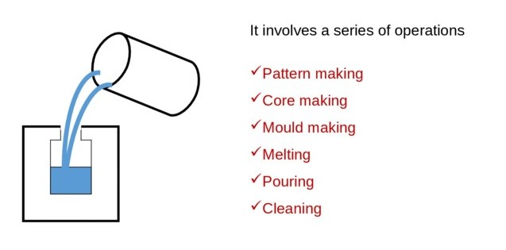
FOUNDRY Foundry is a manufacturing process in which molten metal is poured into a mould cavity & on solidification of it we get our casting or cast job.

Slide 4
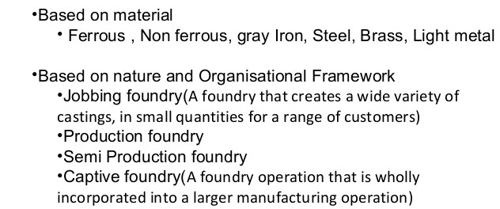
TYPES OF FOUNDRIES

Slide 5
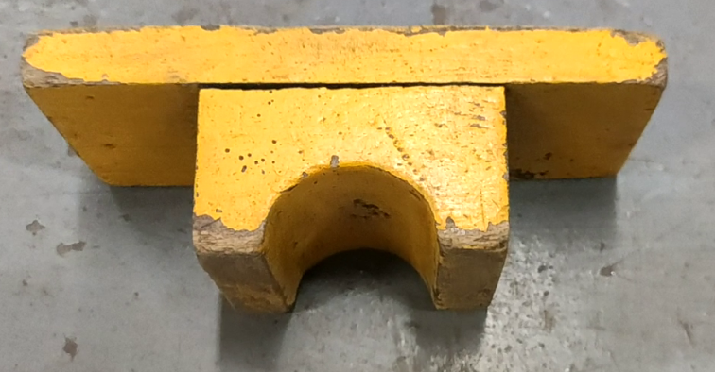
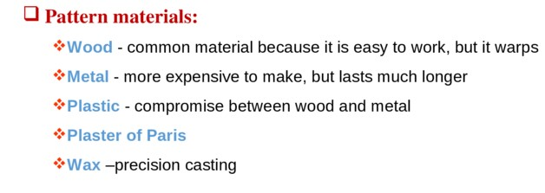
PATTERN A Pattern is a replica of a casting along with some allowances. PATTERN ALLOWANCES i) Shrinkage allowance ii) Machining allowance iii) Draft allowance iv) Distortion allowance

Slide 6
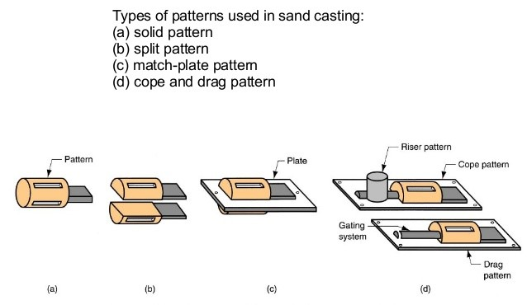
Types of Patterns

Slide 7
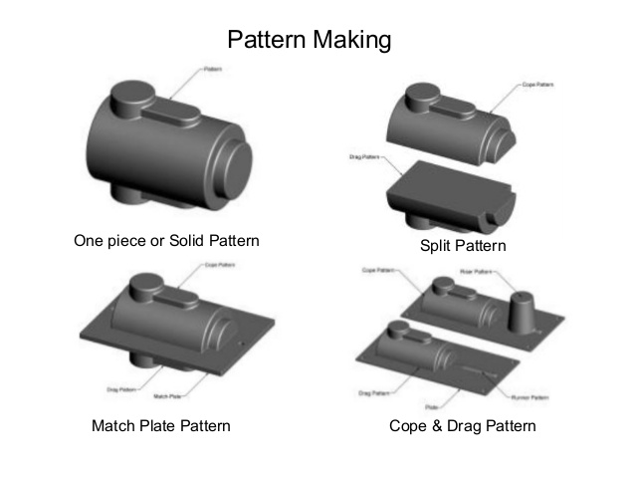

Slide 8
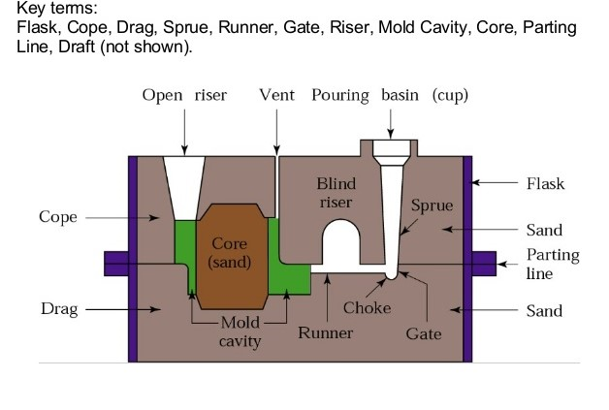
CASTING TERMINOLOGY

Slide 9
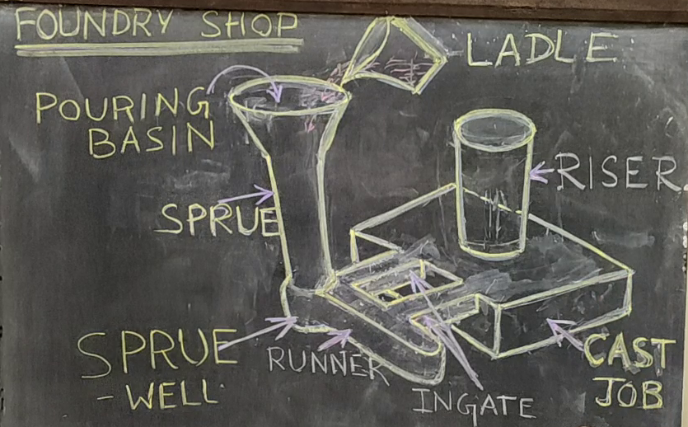

Slide 10
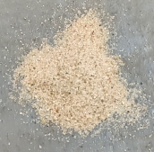
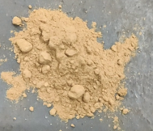
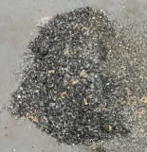
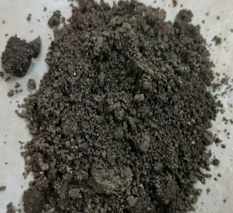
MOLDING SAND
The constituents of molding sand are :-
Silica Sand
Bentonite Powder
Water
Additives
Properties Of Molding Sand :-
Permeability
Cohesive & Adhesive Strength
Moldability
Refractoriness
Reusability

Slide 11
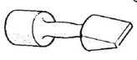
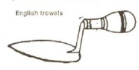
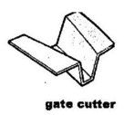
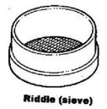
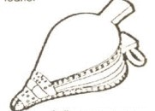
HAND TOOLS USED IN MOLDING
Moulding Boxes : Cope & Drag Box
Rammer
Trowels
Strike Off Bar
Vent wire
Draw spike
Gate Cutters
Bellows
Riddle

Slide 12
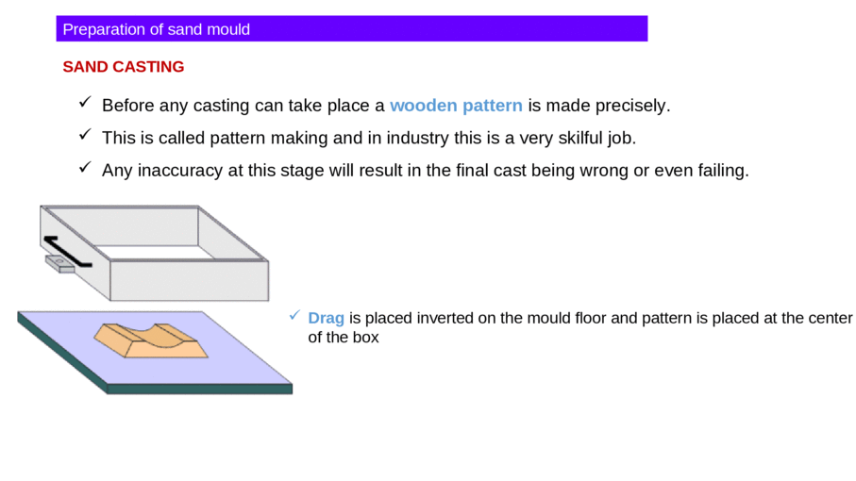
MOULDING PROCEDURE

Slide 13
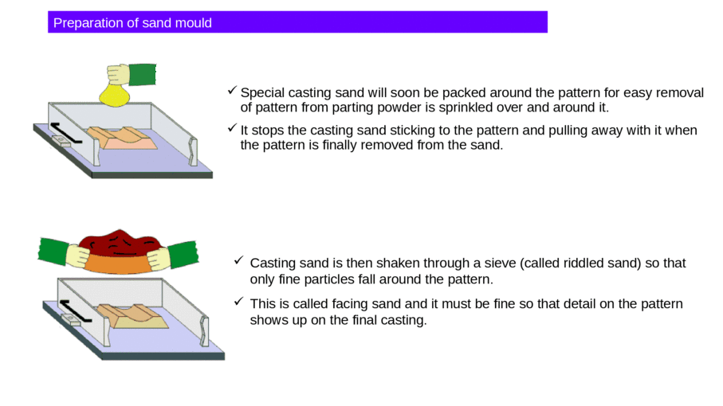

Slide 14
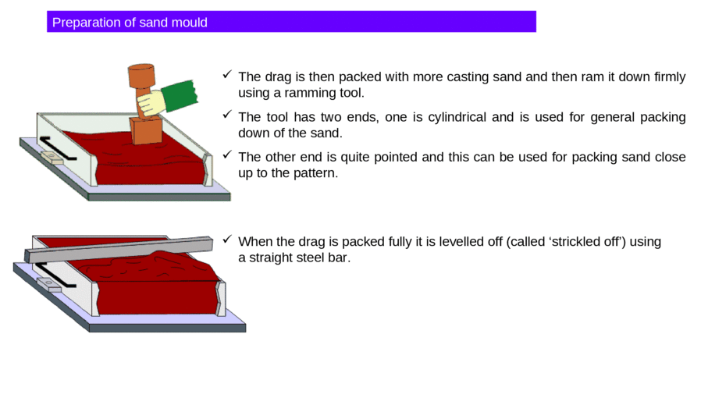

Slide 15
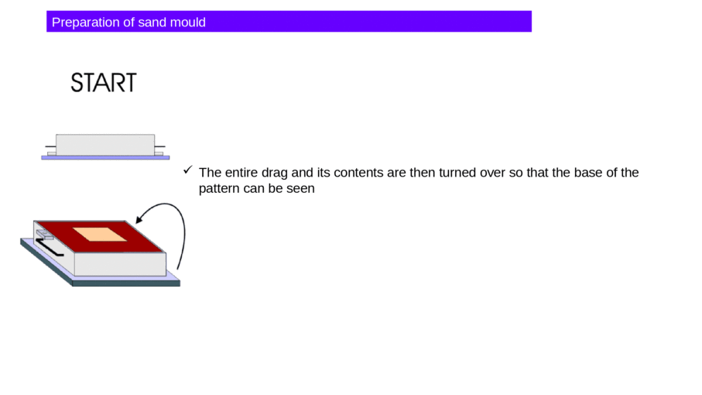

Slide 16
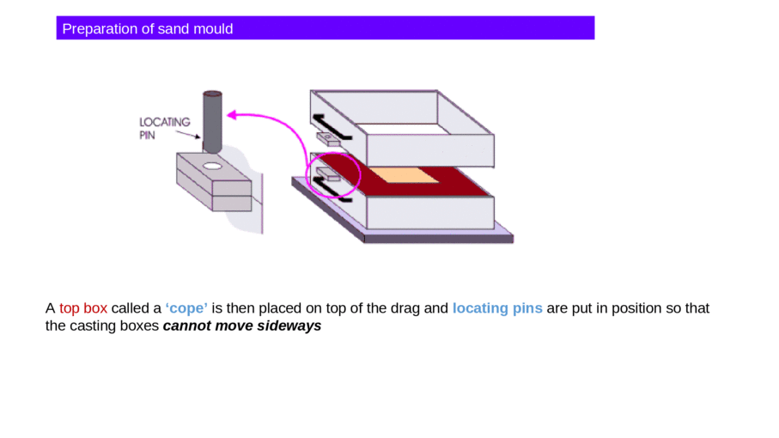

Slide 17
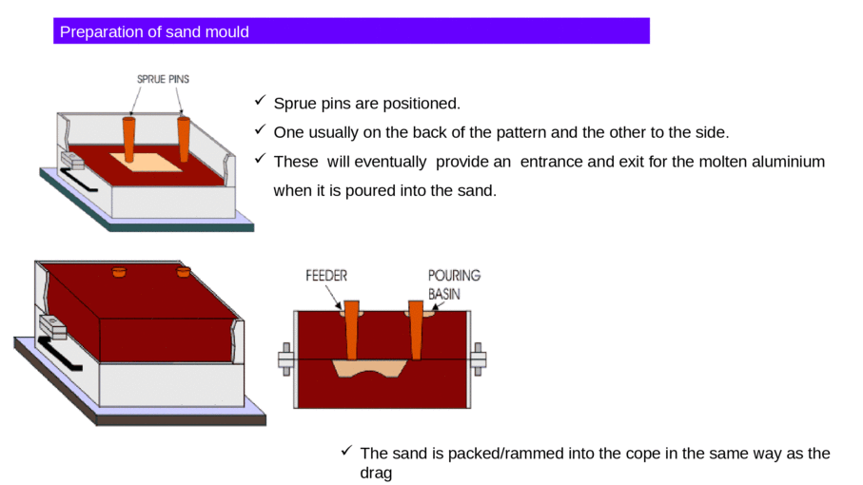

Slide 18
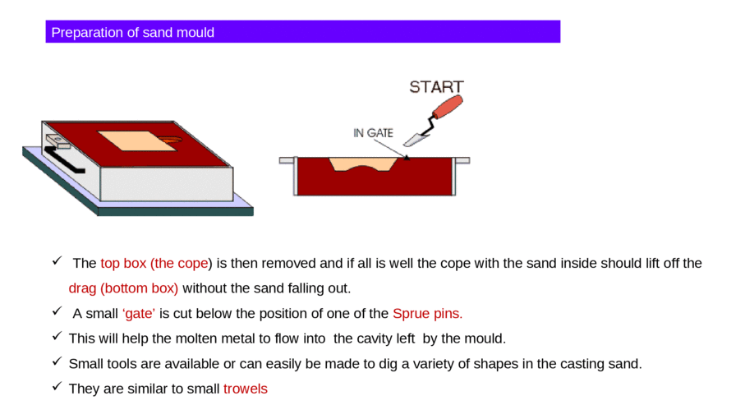

Slide 19
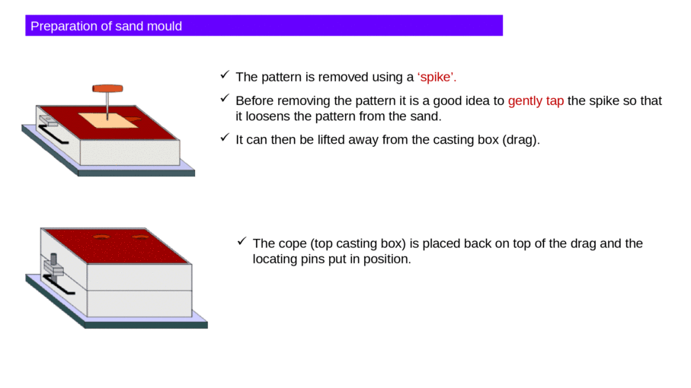

Slide 20
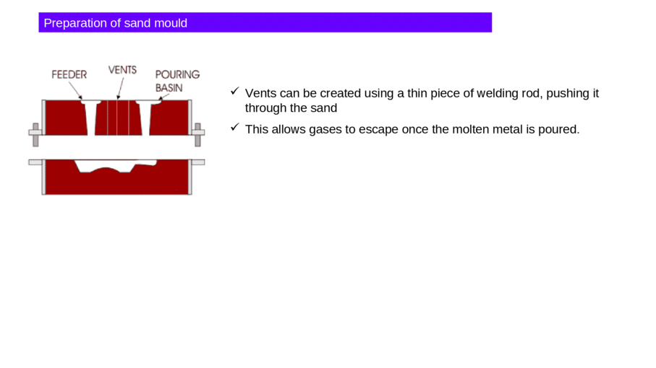

Slide 21
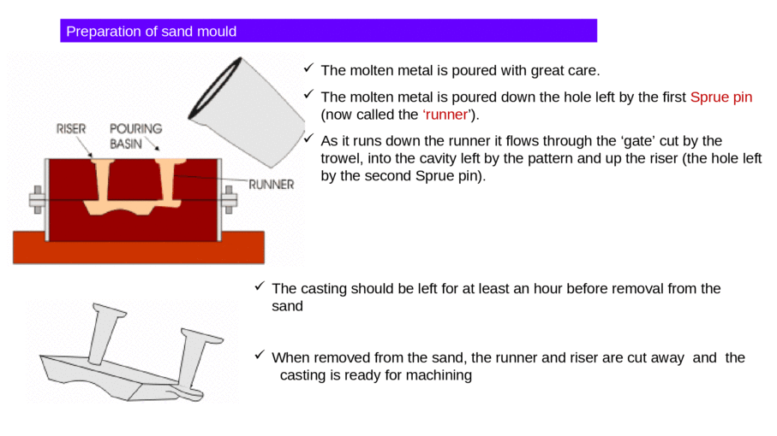

Slide 22
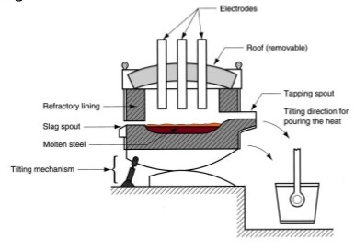
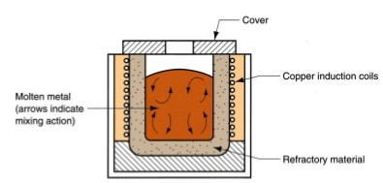
FURNACES FOR CASTING PROCESSES
CUPOLAS
CRUCIBLE FURNACES
ELECTRIC ARC FURNACES
INDUCTION FURNACES

Slide 23
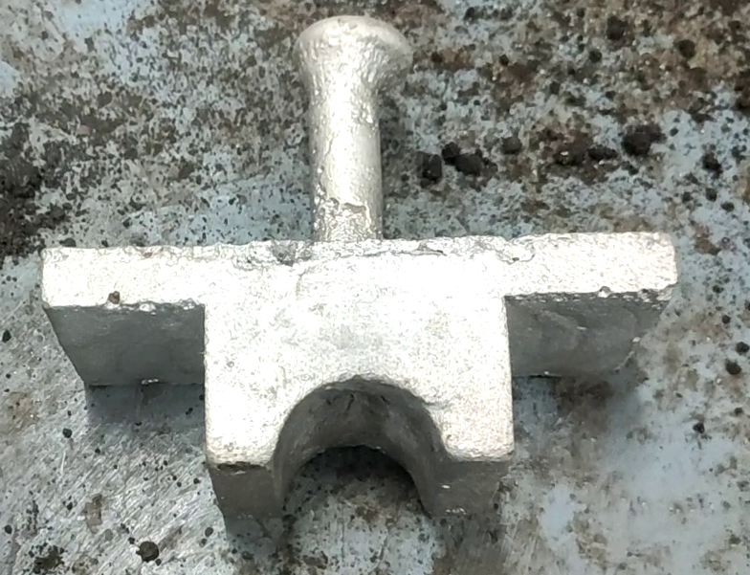
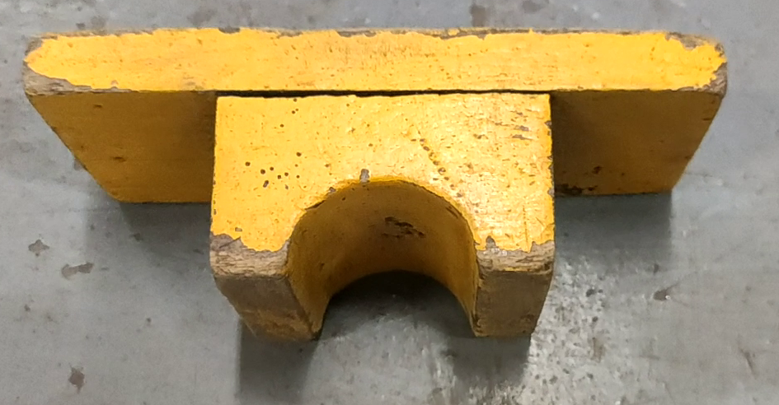
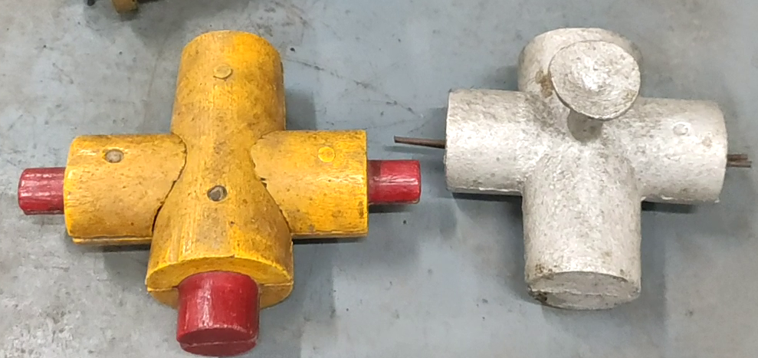
FINAL CAST JOB

Slide 24
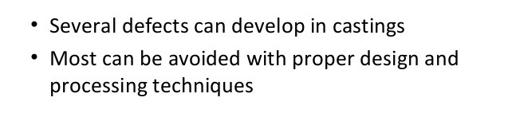
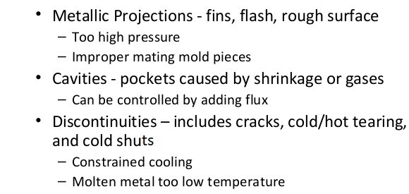
Challenges With Casting

Slide 25
A handwritten Project Report is to be submitted covering the following points
Definition of Foundry with its Classification.
Definition of Pattern with its Classification.
Tools & Equipments used for Molding.
Molding process in brief.
Casting Defects.

